Slide 1
Python Programming

Slide 2
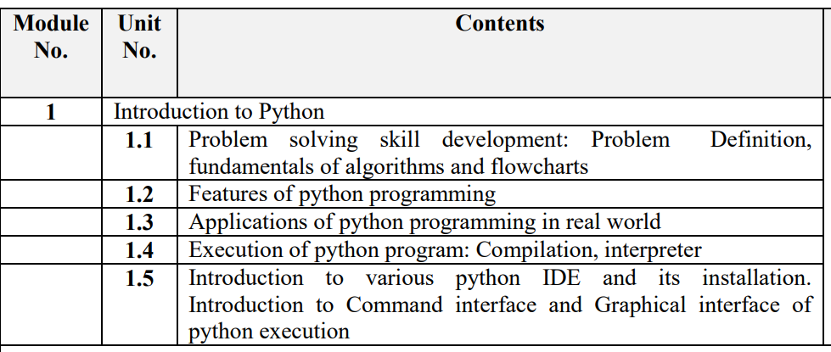
Module 1

Slide 3
What is Python?
Python is a widely-used, interpreted, object-oriented, and high-level programming language with dynamic semantics, used for general-purpose programming.
Python is a high-level programming language which is:
Interpreted: Python is processed at runtime by the interpreter.
Interactive: You can use a Python prompt and interact with the interpreter directly to write your programs.
Object-Oriented: Python supports Object-Oriented technique of programming.
Beginner’s Language: Python is a great language for the beginner-level programmers and supports the development of a wide range of applications.

Slide 4
History of Python
Python was conceptualized by Guido Van Rossum in the late 1980s.
Rossum published the first version of Python code (0.9.0) in February 1991 at the CWI (Centrum Wiskunde& Informatica) in the Netherlands , Amsterdam.
Rossum chose the name "Python", since he was a big fan of Monty Python's Flying Circus.
Guido van Rossum is a Dutch programmer best known as the author of the Python programming language
Python is now maintained by a core development team at the institute, although Rossum still holds a vital role in directing its progress.

Slide 5
What makes Python special?
How does it happen that programmers, young and old, experienced and novice, want to use it? How did it happen that large companies adopted Python and implemented their flagship products using it?
There are many reasons – we've listed some of them already, but let's enumerate them again in a more practical manner:
it's easy to learn – the time needed to learn Python is shorter than for many other languages; this means that it's possible to start the actual programming faster;
it's easy to teach – the teaching workload is smaller than that needed by other languages; this means that the teacher can put more emphasis on general (language-independent) programming techniques, not wasting energy on exotic tricks, strange exceptions and incomprehensible rules;
it's easy to use for writing new software – it's often possible to write code faster when using Python;
it's easy to understand - it's also often easier to understand someone else's code faster if it is written in Python;
it's easy to obtain, install and deploy – Python is free, open and multiplatform; not all languages can boast that.
Of course, Python has its drawbacks, too:
it's not a speed demon – Python does not deliver exceptional performance;
in some cases it may be resistant to some simpler testing techniques – this may mean that debugging Python code can be more difficult than with other languages; fortunately, making mistakes is also harder in Python.

Slide 6
Features of Python
1. Easy to Code
Python is a very high-level programming language, yet it is effortless to learn. Learning the basic Python syntax is very easy, as compared to other popular languages like C, C++, and Java.
2. Easy to Read
Python code looks like simple English words. There is no use of semicolons or brackets, and the indentations define the code block. You can tell what the code is supposed to do simply by looking at it.
3. Free and Open-Source
Python is developed under an OSI-approved open source license. Hence, it is completely free to use, even for commercial purposes.
4. Dynamically Typed
Many programming languages need to declare the type of the variable before runtime. With Python, the type of the variable can be decided during runtime. This makes Python a dynamically typed language.
For example, if you have to assign an integer value 20 to a variable “x”, you don’t need to write int x = 20. You just have to write x = 20.

Slide 7
4. Robust Standard Library
Python has an extensive standard library available for anyone to use. This means that programmers don’t have to write their code for every single thing unlike other programming languages.
5. Interpreted
When a programming language is interpreted, it means that the source code is executed line by line, and not all at once. Programming languages such as C++ or Java are not interpreted, and hence need to be compiled first to run them.
6. Portable
Python is portable in the sense that the same code can be used on different machines. As such, there is no need to write a program multiple times for several platforms.
7. Object-Oriented and Procedure-Oriented
A programming language is object-oriented if it focuses design around data and objects, rather than functions and logic. On the contrary, a programming language is procedure-oriented if it focuses more on functions (code that can be reused). One of the critical Python features is that it supports both object-oriented and procedure-oriented programming.

Slide 8
8. Extensible
A programming language is said to be extensible if it can be extended to other languages. Python code can also be written in other languages like C++, making it a highly extensible language.
9. Expressive
Python needs to use only a few lines of code to perform complex tasks. For example, to display Hello World, you simply need to type one line - print(“Hello World”).
10. Support for GUI
One of the key aspects of any programming language is support for GUI or Graphical User Interface. A user can easily interact with the software using a GUI. Python offers various toolkits, such as Tkinter, wxPython and JPython, which allows for GUI's easy and fast development.
12. High-level Language
Python is a high-level programming language because programmers don’t need to remember the system architecture, nor do they have to manage the memory.
13. Simplify Complex Software Development
Python can be used to develop both desktop and web apps and complex scientific and numerical applications. Python's data analysis features help you create custom big data solutions without so much time and effort. You can also use the Python data visualization libraries and APIs to present data in a more appealing way.

Slide 9
Applications of Python
1. Embedded scripting language: Python is used as an embedded scripting language for various testing/ building/ deployment/ monitoring frameworks, scientific apps, and quick scripts.
2. 3D Software:3D software like Maya uses Python for automating small user tasks, or for doing more complex integration such as talking to databases and asset management systems.
3. Web development: Python is an easily extensible language that provides good integration with database and other web standards.
4. GUI-based desktop applications: Simple syntax, modular architecture, rich text processing tools and the ability to work on multiple operating systems makes Python a preferred choice for developing desktop-based applications.
5. Image processing and graphic design applications: Python is used to make 2D imaging software such as Inkscape, GIMP, Paint Shop Pro and Scribus.

Slide 10
6. Scientific and computational applications: Features like high speed, productivity and availability of tools, such as Scientific Python and Numeric Python, have made Python a preferred language to perform computation and processing of scientific data. 3D modeling software, such as FreeCAD, and finite element method software, like Abaqus, are coded in Python.
7. Games: Python has various modules, libraries, and platforms that support development of games. Games like Civilization-IV, Disney's Toontown Online, Vega Strike, etc. are coded using Python.
8. Enterprise and business applications: Simple and reliable syntax, modules and libraries, extensibility, scalability together make Python a suitable coding language for customizing larger applications. For example, Reddit which was originally written in Common Lips, was rewritten in Python in 2005. A large part of Youtube code is also written in Python

Slide 11
Interpreter vs Compiler
Interpreter translates just one statement of the program at a time into machine code. | Compiler scans the entire program and translates the whole of it into machine code at once.
An interpreter takes very less time to analyze the source code. However, the overall time to execute the process is much slower. | A compiler takes a lot of time to analyze the source code. However, the overall time taken to execute the process is much faster.
An interpreter does not generate an intermediary code. Hence, an interpreter is highly efficient in terms of its memory. | A compiler always generates an intermediary object code. It will need further linking. Hence more memory is needed.

Slide 12
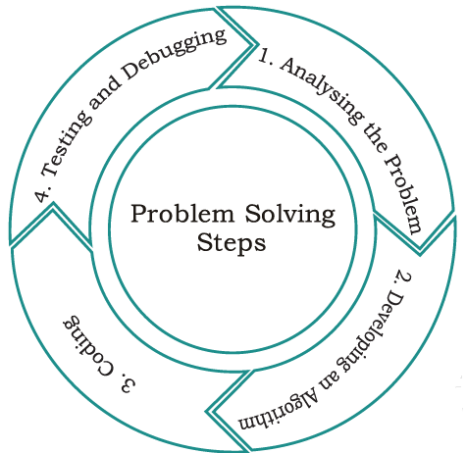
STEPS FOR PROBLEM SOLVING

Slide 13
Step 1: Analysing the problem
Clearly understand a problem before designing the solution for it, otherwise we may end up developing a program which may not solve our purpose.
Read and analyze the problem statement carefully and list the principal components of the problem and decide the core functionalities that our solution should have.
Analyze the problem to figure out what are the inputs that our program should accept and the outputs that it should produce.

Slide 14
Step 2: Developing an Algorithm
An algorithm is a sequence of instructions for computing an answer (output) for a problem and data (input).
An algorithm is in a natural language, i.e., a language that humans can easily understand and independent of the programming language.
Remember that computers are just machines that will execute the instructions as given.
It is essential to device an algorithm, before you write your program.

Slide 15
Step 2: Developing an Algorithm
An algorithm is like a very well-written recipe for a dish, with clearly defined steps that, if followed, one will end up preparing the dish as expected.
We start with a tentative solution plan and keep on refining the algorithm until the algorithm is able to capture all the aspects of the desired solution.
For a given problem, more than one algorithm may be possible, in such cases we have to select the most suitable solution, based on some criteria like the time constraints, space constraints, accuracy required etc.

Slide 16
Step 3: Coding
The computer cannot understand the algorithm written in natural language that we have finalized in the previous step directly.
We need to convert the algorithm into a program, which is written in a programming language that can be understood by the computer.
The program will take inputs and generate the desired output.

Slide 17
Low Level Prog. Languages
Low-Level language is the only language which can be understood by the computer.
Low-level language is also known as Machine Language.
The machine language contains only two symbols 1 & 0.
All the instructions of machine language are written in the form of binary numbers 1's & 0's.
A computer can directly understand the machine language.

Slide 18
High Level Prog. Languages
High-level language is a computer language which can be understood by the users.
The high-level language is very similar to human languages and has a set of grammar rules that are used to make instructions more easily.
Every high-level language has a set of predefined words known as Keywords and a set of rules known as Syntax to create instructions.
The high-level language is easier to understand for the users but the computer can not understand it.

Slide 19
Step 3: Coding
Different high level programming languages can be used for writing a program.
Examples: Python, C, C++, Java
It is equally important to record the details of the coding procedures followed and document the solution.
This is helpful when revisiting the programs at a later stage.

Slide 20
Step 4 : Testing and Debugging
The program is tested for syntactical errors.
The program is tested on various parameters such that it meets the requirements of the user.
It must respond within the expected time.
It should generate correct output for all possible inputs.
In case the output generated is incorrect, then the program should be checked for logical errors, if any.

Slide 21
Step 4 : Testing and Debugging
Software industry follows standardized testing methods while developing complex applications like:
unit or component testing,
integration testing,
system testing, and
acceptance testing
This is to ensure that the software meets all the business and technical requirements and works as expected.

Slide 22
Variables and Identifiers
Variable means its value can vary. You can store any piece of information in a variable. Variables are nothing but just parts of your computer’s memory where information is stored. To be identified easily, each variable is given an appropriate name.
Identifiers are names given to identify something. This something can be a variable, function, class, module or other object.
For naming any identifier, there are some basic rules like:
• The first character of an identifier must be an underscore ('_') or a letter (upper or lowercase).
• The rest of the identifier name can be underscores ('_'), letters (upper or lowercase), or digits (0-9).
• Identifier names are case-sensitive. For example, myvar and myVar are not same.

Slide 23
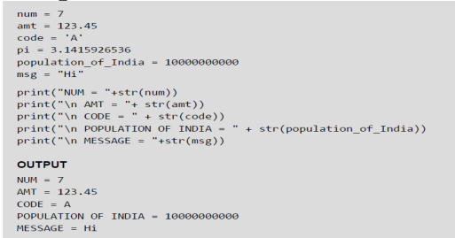
Assigning or Initializing Values to Variables
In Python, programmers need not explicitly declare variables to reserve memory space. The declaration is done automatically when a value is assigned to the variable using the equal sign (=). The operand on the left side of equal sign is the name of the variable and the operand on its right side is the value to be stored in that variable.

Slide 24
Python Features
1. Free and Open Source
2. Easy to code
4. Object-Oriented Language
5. GUI Programming Support
6. GUI Programming Support
7. Large Community Support
8. Easy to Debug
9. Python is a Portable language
10. Python is an Integrated language
11. Large Standard Library
12. Frontend and backend development
13. Allocating Memory Dynamically

Slide 25
Python IDEs and Code Editors
Firstly understand that IDE and code editor both are different things.
Text/Code Editor:
Code editors are the lightweight tool that allows you to
write and edit the code with some features such as syntax highlighting and code formatting.
It provided fewer features than IDE.

Slide 26
Python IDEs and Code Editors
An integrated development environment(IDE) is a software application that provides comprehensive facilities to computer programmers for software development.
An IDE normally consists of a source code editor, build automation tools, and a debugger.
Most of the modern IDEs have intelligent code completion.

Slide 27
Python IDEs and Code Editors
Integrated Development Environment (IDE):
IDEs are full-fledged environment which provide all the essential tools needed for software development.
It just doesn’t handle the code (for example, write, edit, syntax highlighting and auto-completion) but also provides other features such as debugging, execution, testing, and code formatting that helps programmers.

Slide 28
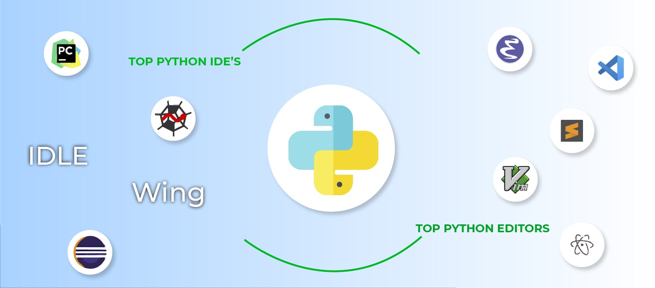
Python IDEs and Code Editors
List of Best Python IDE
PyCharm
Spyder
Eclipse PyDev
IDLE
Wing

Slide 29
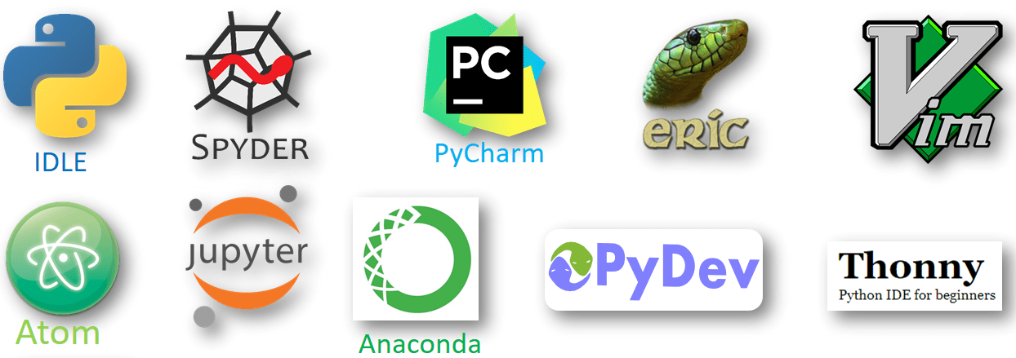
Python IDEs and Code Editors

Slide 30
Python IDEs and Code Editors
PyCharm-
In industries most of the professional developers use PyCharm and it has been considered the best IDE for python developers.
It gives daily tips to improve your knowledge of how you can use it more efficiently which is a very good feature.
It comes in two versions community version and a professional version where community version is free but the professional version is paid.

Slide 31
Python IDEs and Code Editors
Spyder-
Spyder is another good open-source and cross-platform IDE written in Python.
Scientific Python Development IDE
Most lightweight IDE for Python.
It is mainly used by data scientists who can integrate with Matplotlib, SciPy, NumPy, Pandas, Cython, IPython, SymPy, and other open-source software.

Slide 32
Python IDEs and Code Editors
Eclipse PyDev-
Eclipse is one of the most popular IDE among developers which is written in Java but you can install Pydev plugin in eclipse and use it for Python as well.
The primary focus of this IDE is the analysis of code, debugging in the graphical pattern, refactoring of python code, etc.

Slide 33
Python IDEs and Code Editors
IDLE-
IDLE is a cross-platform open-source IDE that comes by default with Python so you don’t need to worry about the installation or setup.
IDLE is written in Python
Suitable for beginner level developers who want to practice on python development.

Slide 34
Python IDEs and Code Editors
IDLE-
IDLE is lightweight and simple to use
Can be Used to build simple projects such as web browser game automation, basic web scraping applications, and office automation.
This IDE is not good for larger projects so move to some advance IDEs after learning the basics from IDLE.

Slide 35
Python IDEs and Code Editors
Wing-
Wing IDE is created by Wingware and it is faster, stable and extremely lightweight cross-platform Python IDE.
It comes in three editions:
Wing Pro (Free Trial): A full-featured commercial version, for professional programmers.
Wing Personal (Paid): Free version that omits some features, for students and hobbyists.
Wing 101 (Paid): A very simplified free version, for beginners in programming.

Slide 36
Python Shell
Python Shell –running 'python' from the Command Line opens this interactive shell

Slide 37
Jupyter Notebook
Popular web application or tool which is mainly used for data science projects
It’s well known in the data science community for analyzing, sharing and presenting the information.
Has Integrated data science libraries (matplotlib, NumPy, Pandas).

Slide 38
Jupyter Notebook
Jupyter Notebook is a web-based interactive development environment;
It is easy to use, open-source software that allows you to create and share live code, visualizations, etc.
It offers you to see and edit your code to create powerful presentations.
You can also convert your complete work into PDF and HTML files, or you can just export it as a .py file.

Slide 39
Jupyter Notebook
Project Jupyter is a project to develop open-source software, open standards, and services for interactive computing across multiple programming languages.
Project Jupyter's name is a reference to the three core programming languages supported by Jupyter, which are
Julia,
Python and
R.

Slide 40

Jupyter Notebook
Its name and logo are an homage to Galileo's discovery of the moons of Jupiter, as documented in notebooks attributed to Galileo.

Slide 41
Jupyter Notebook
Project Jupyter has developed and supported the interactive computing products
Jupyter Notebook,
JupyterHub, and
JupyterLab.
Jupyter is financially sponsored by NumFOCUS

Slide 42
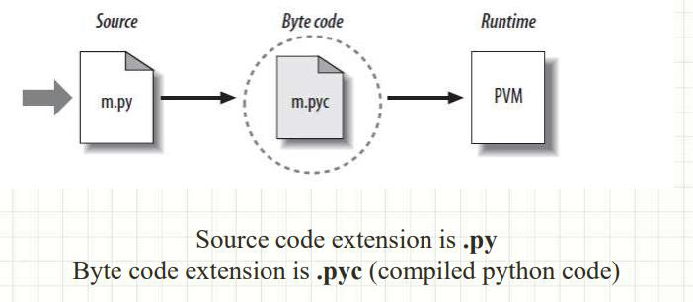
Python Code Execution
Python’s traditional runtime execution model:
source code you type is translated to byte code,
which is then run by the Python Virtual Machine.
Your code is automatically compiled, but then it is interpreted.

Slide 43
Python Code Execution
Suppose the a python program is saved as first.py.
Here first is the name and .py is the extension.
The execution of the Python program involves 2 Steps:
Compilation
Interpreter

Slide 44
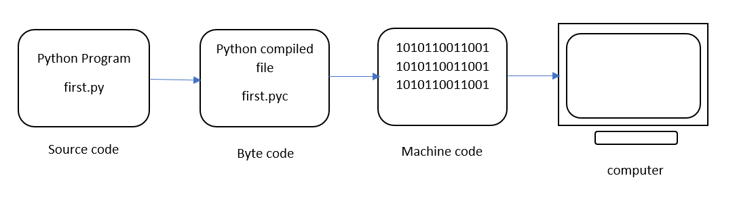
Python Code Execution

Slide 45
Python Code Execution
Compilation
The program is converted into byte code.
Byte code is a fixed set of instructions that represent arithmetic, comparison, memory operations, etc.
It can run on any operating system and hardware.
The byte code instructions are created in the .pyc file.
The .pyc file is not explicitly created as Python handles it internally

Slide 46
Python Code Execution
Interpreter
The next step involves converting the byte code (.pyc file) into machine code.
This step is necessary as the computer can understand only machine code (binary code).
Python Virtual Machine (PVM) first understands the operating system and processor in the computer and then converts it into machine code.
Further, these machine code instructions are executed by processor and the results are displayed.

Slide 47
Python Code Execution
Interpreter
However, the interpreter inside the PVM translates the program line by line thereby consuming a lot of time.

Slide 48
Python Installation
To install Python on a Windows machine, follow these steps:
1. Open a web browser and go to http://www.python.org.
2. Click the Download link.
3. You should see several links here, with names such as Python 2.5.x and Python 2.5.x Windows installer. Click the Windows installer link to download the installer file. (If you’re running on an Itanium or AMD machine, you need to choose the appropriate installer)
4. Store the Windows Installer file somewhere on your computer, such as C:\download\
python-2.5.x.msi. (Just create a directory where you can find it later.)
5. Run the downloaded file by double-clicking it in Windows Explorer. This brings up the Python install wizard, which is really easy to use. Just accept the default settings, wait until the installation is finished, and you’re ready to roll!

Slide 49
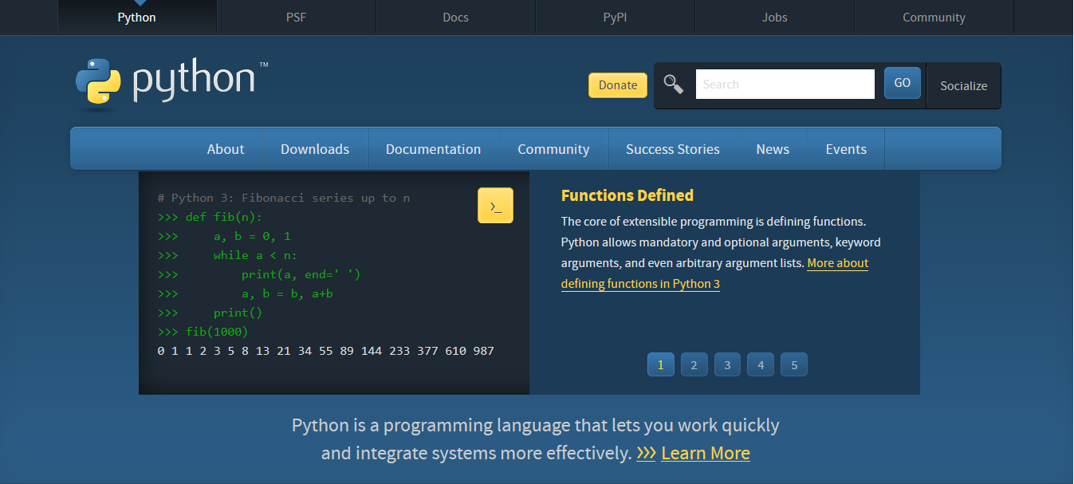
Python Installation
To install Python on a Windows machine, follow these steps:
1. Open a web browser and go to http://www.python.org.

Slide 50
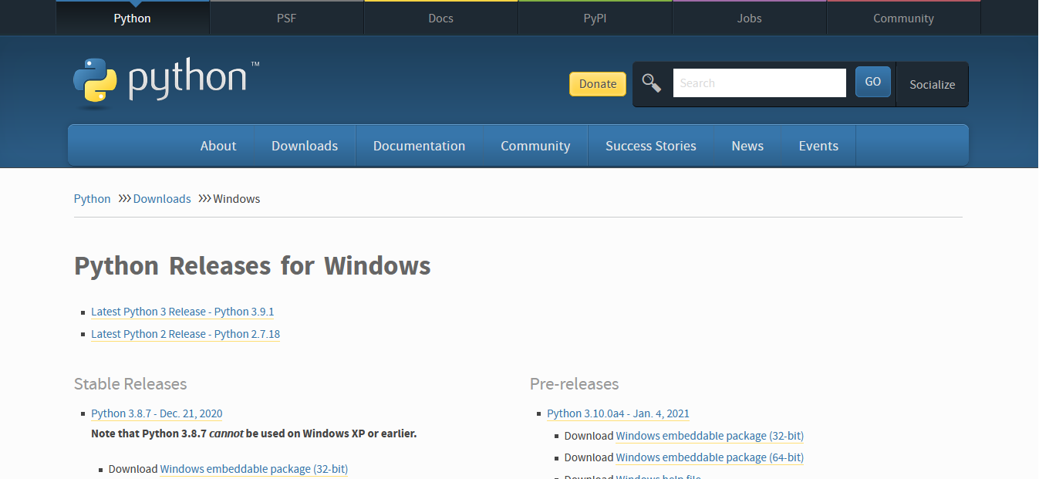
Python Installation
2. Click the Download link.

Slide 51
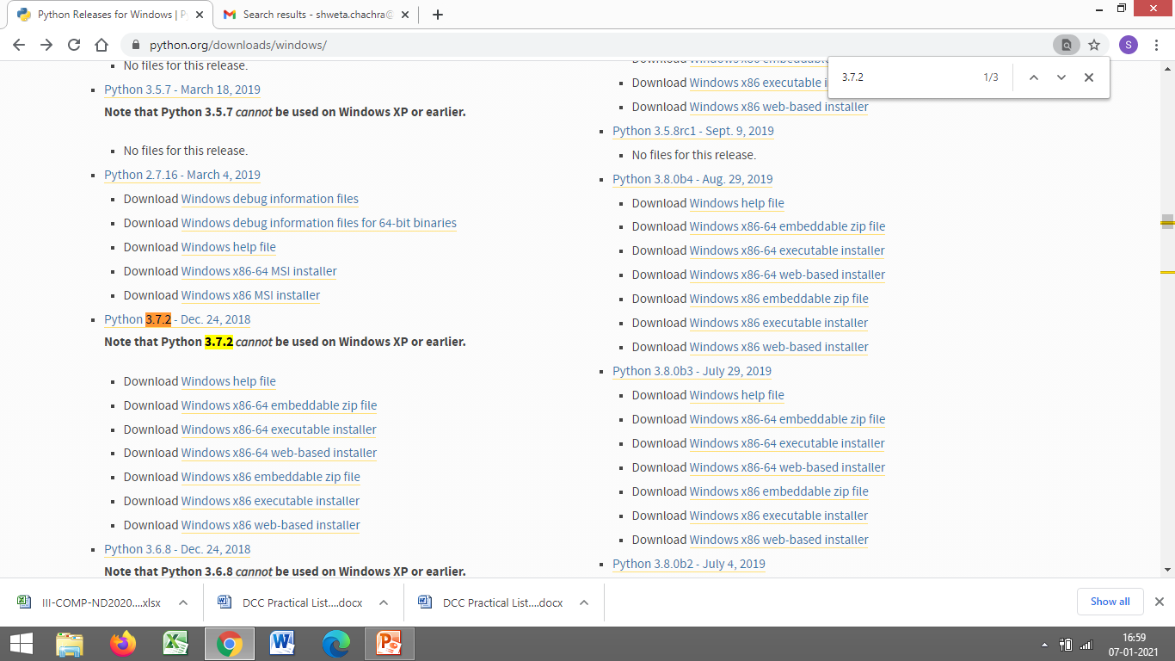
Python Installation
3. You should see several links here, with names such as Python 2.5.x and Python 2.5.x Windows installer. Click the Windows installer link to download the installer file. (If you’re running on an Itanium or AMD machine, you need to choose the appropriate installer)

Slide 52
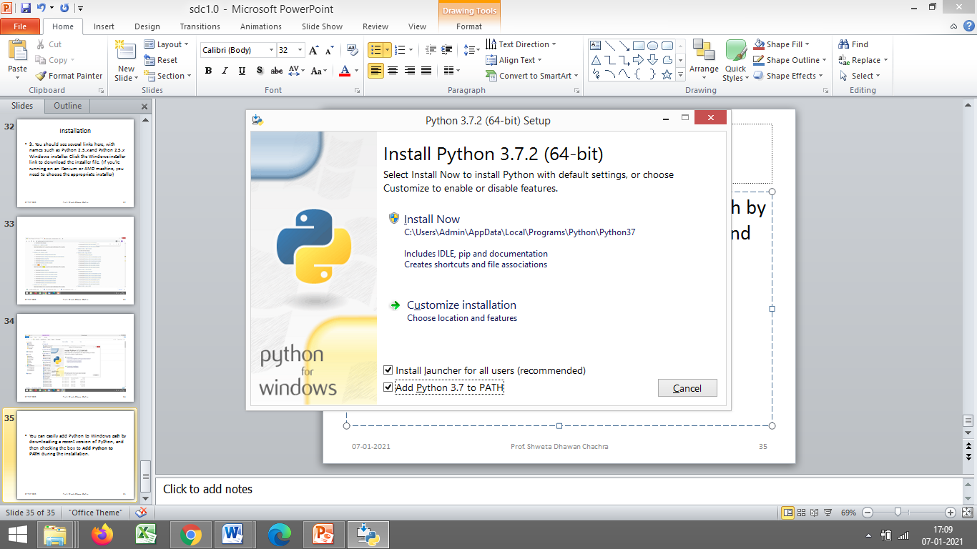
Python Installation
You can easily add Python to Windows path by downloading a recent version of Python, and then checking the box to Add Python to PATH during the installation.

Slide 53
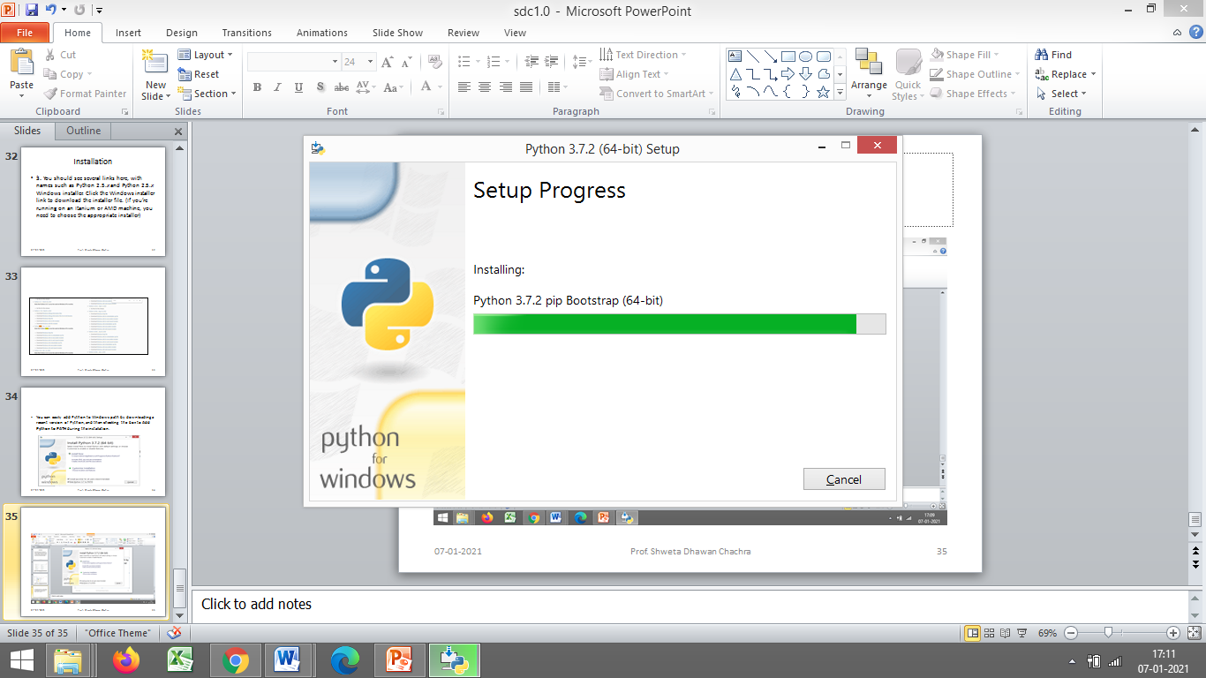
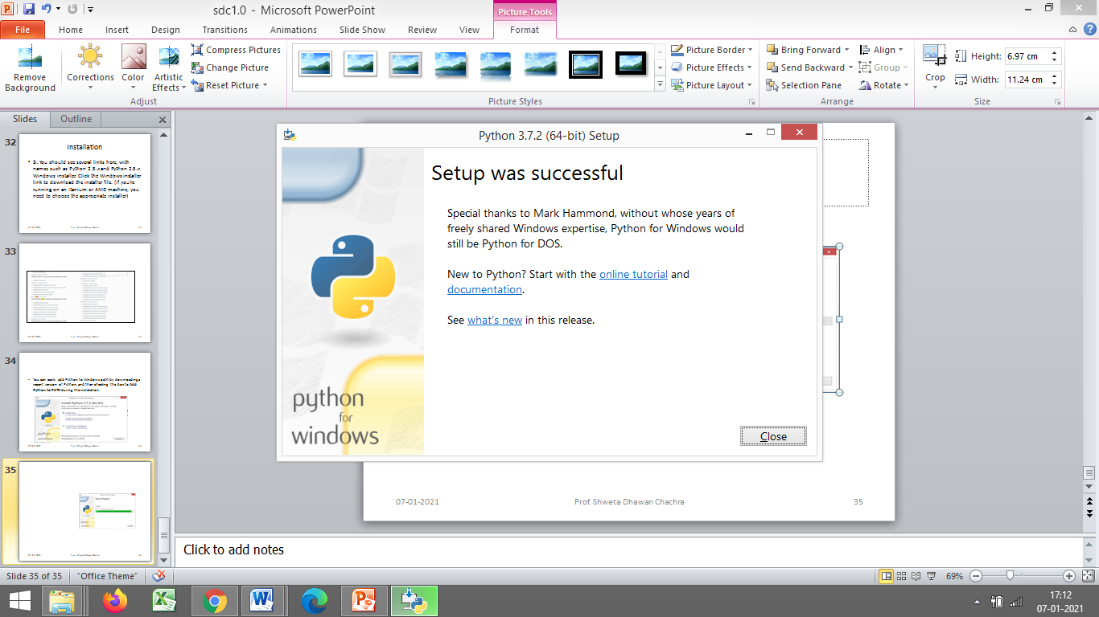
Python Installation

Slide 54
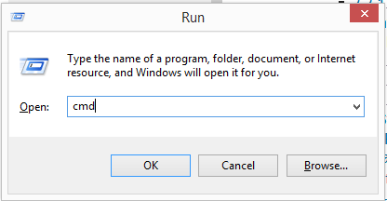
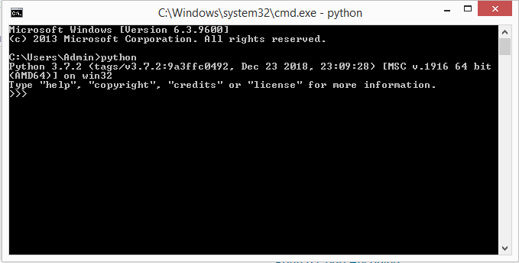
Running Python Shell
To run the Python Shell, open the command prompt or power shell on Windows and terminal window on mac, write python and press enter.
A Python Prompt comprising of three greater-than symbols >>> appears, as shown below.

Slide 55
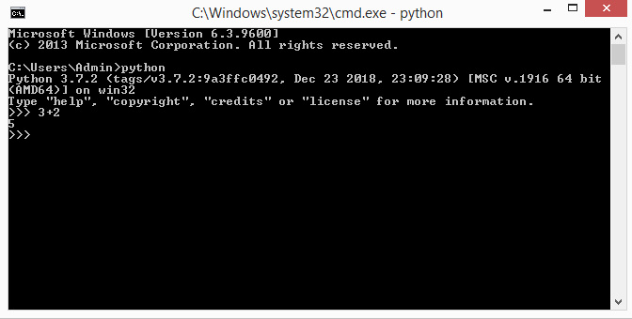
Running Python Shell
Now, you can enter a single statement and get the result.
For example, enter a simple expression like 3 + 2, press enter and it will display the result in the next line, as shown below.

Slide 56

Executing a .py program from command prompt
Open cmd prompt
Open notepad, Create a .py file
execute using python filename

Slide 57
Getting started with Python IDLE
If you’ve recently downloaded Python onto your computer, then you may have noticed a new program on your machine called IDLE.
You might be wondering, “What is this program doing on my computer? I didn’t download that!” While you may not have downloaded this program on your own, IDLE comes bundled with every Python installation.
It’s there to help you get started with the language right out of the box.

Slide 58
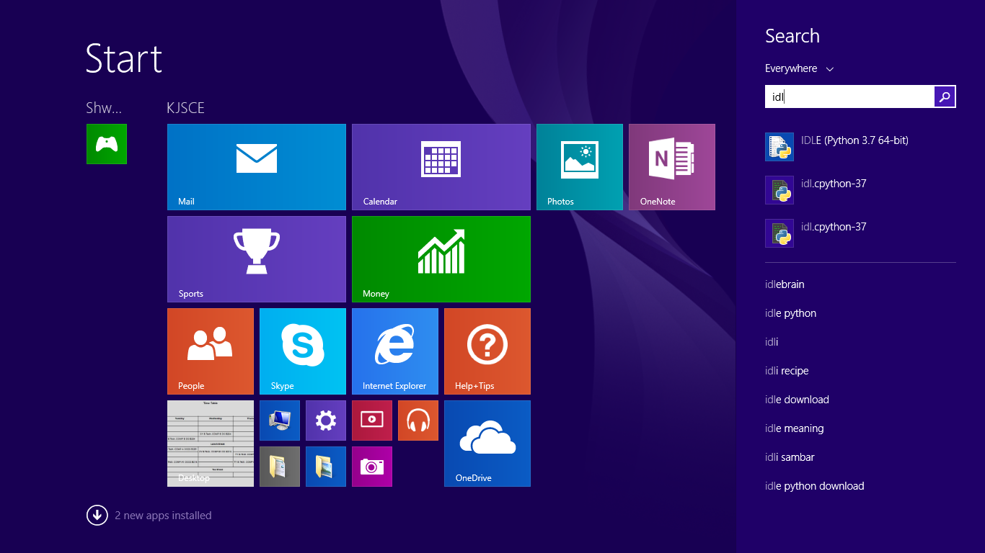
Getting started with Python IDLE
What Is Python IDLE?
Every Python installation comes with an Integrated Development and Learning Environment, which you’ll see shortened to IDLE or even IDE.

Slide 59
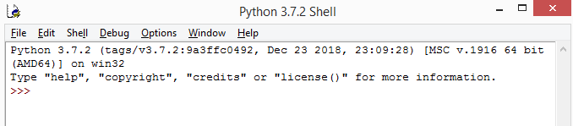
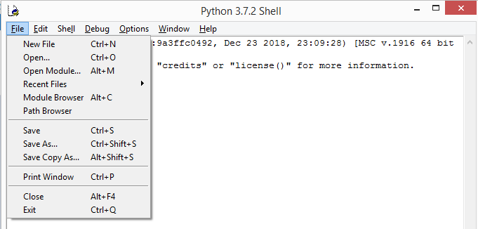
Getting started with Python IDLE
This is how IDLE looks
To write a python program
Click on File ->New File

Slide 60
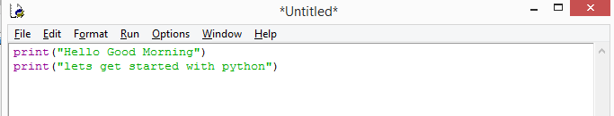
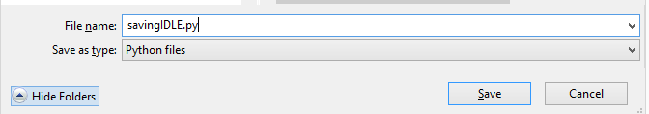
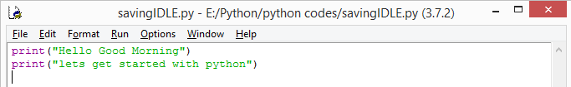
Getting started with Python IDLE
New File will be opened
Write your code
Save your program with a .py extension
The program gets saved

Slide 61
Getting started with Python IDLE
The bar along the top of the program window contains three pieces of important information:
The name of the file that you’re editing
The full path to the folder where you can find this file on your computer
The version of Python that IDLE is using

Slide 62
Getting started with Python IDLE
Here,
You’re editing the file savingIDLE.py,
Located in the pythoncodes folder.
The Python version is 3.7.2, which you can see in parentheses.

Slide 63

Getting started with Python IDLE
There are also two numbers in the bottom right corner of the window:
Ln: shows the line number that your cursor is on.
Col: shows the column number that your cursor is on.

Slide 64
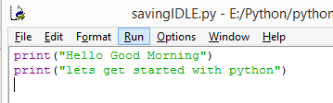
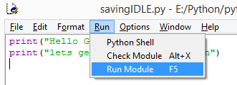

Getting started with Python IDLE
For execution-Click on Run
Select Run Module
Output visible in the Python Shell

Slide 65
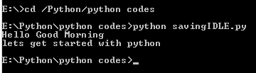
Running using Python Shell
Running the same program saved via IDLE on command prompt
Is it possible?
Yes
Navigate to that particular path
Type python filename.py to execute the code

Slide 66
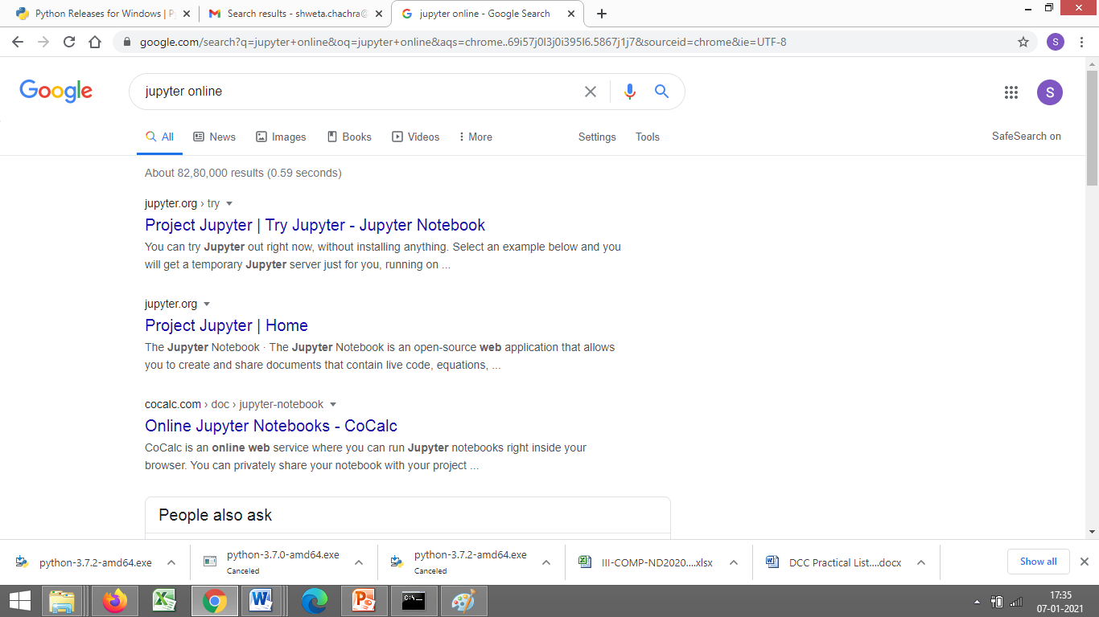
Kick starting Jupyter Notebook
Type jupyter online on google

Slide 67
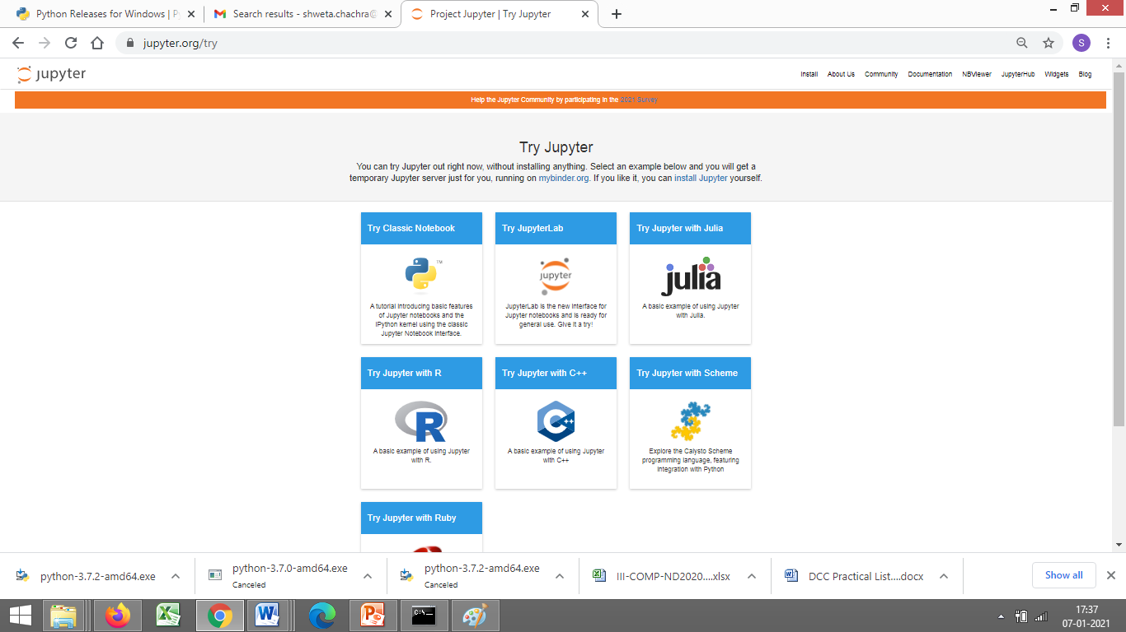
Jupyter Notebook
Select Jupyter Lab icon

Slide 68
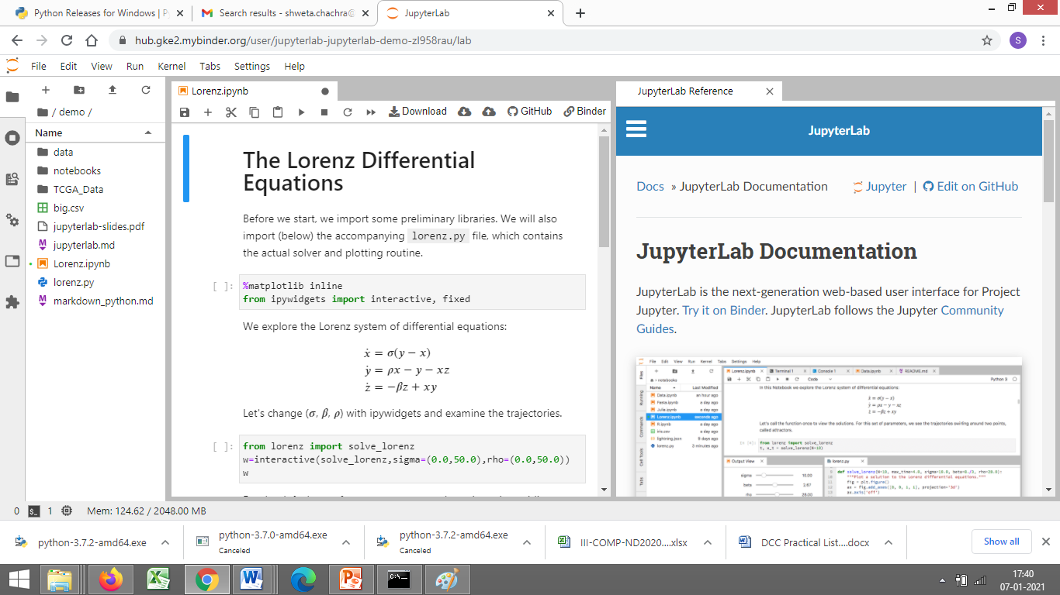
Jupyter Notebook
On Selecting Jupyter Lab icon

Slide 69
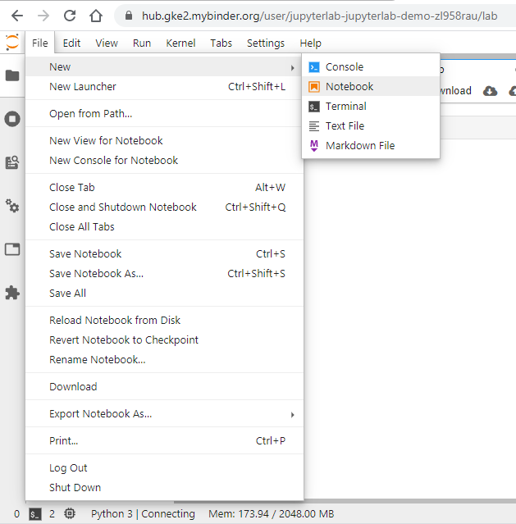
Jupyter Notebook
Open Jupyter notebook

Slide 70
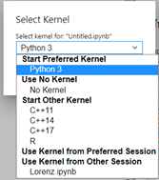
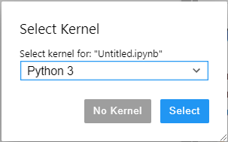
Jupyter Notebook
Select Kernel

Slide 71
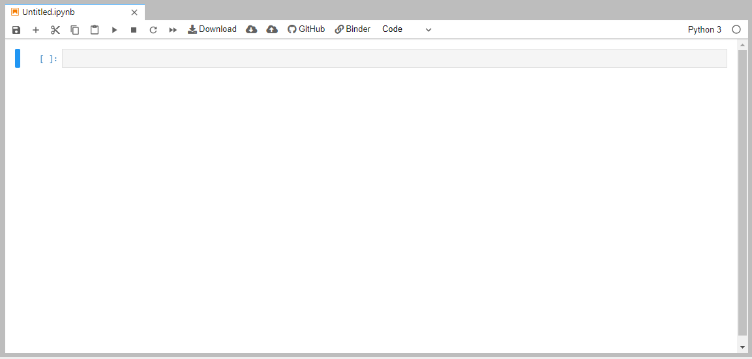
Jupyter Notebook
The Cell in which we write code

Slide 72
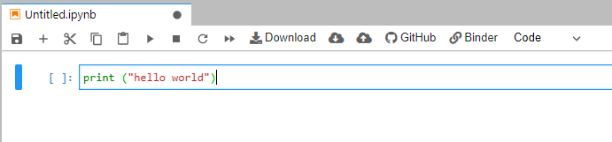
Jupyter Notebook
One line code or multi line code written in the cell will be executed at a time

Slide 73
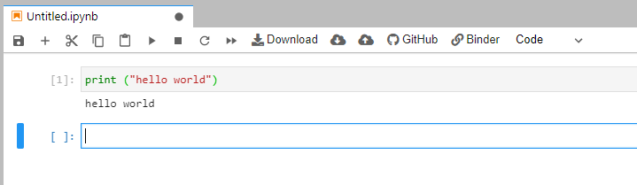
Jupyter Notebook
Click on Play icon
Number is assigned after execution
Else star is there in square bracket
o/p is on next step

Slide 74
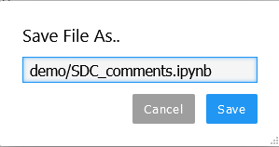
On Jupyter, File gets saved by ipynb extension by default

Slide 75
Anaconda
Anaconda is a distribution of the Python and R programming languages
for scientific computing
data science,
machine learning applications,
large-scale data processing,
predictive analytics, etc.
that aims to simplify package management and deployment.
The distribution includes data-science packages suitable for Windows, Linux, and macOS.

Slide 76
More on Algorithms and Flowcharts

Slide 77
Why do we need an Algorithm?
The programmer first prepares a roadmap of the program to be written, before actually writing the code.
Without a roadmap, the programmer may not be able to clearly visualize the instructions to be written and may end up developing a program which may not work as expected.
Such a roadmap is nothing but the algorithm which is the building block of a computer program.
If the algorithm is correct, computer will run the program correctly, every time.
So, the purpose of using an algorithm is to increase the reliability, accuracy and efficiency of obtaining solutions.

Slide 78
Characteristics of a good algorithm
Precision — the steps are precisely stated or defined.
Uniqueness — results of each step are uniquely defined and only depend on the input and the result of the preceding steps.
Finiteness — the algorithm always stops after a finite number of steps.
Input — the algorithm receives some input.
Output — the algorithm produces some output.

Slide 79
While writing an algorithm, it is required to clearly identify the following:
The input to be taken from the user
Processing or computation to be performed to get the desired result
The output desired by the user

Slide 80
REPRESENTATION OF ALGORITHMS:
Using their algorithmic thinking skills, the software designers or programmers analyze the problem and identify the logical steps that need to be followed to reach a solution.
Once the steps are identified, the need is to write down these steps along with the required input and desired output.
There are two common methods of representing an algorithm —Flowchart and pseudo code.
Either of the methods can be used to represent an algorithm while keeping in mind the following:
it showcases the logic of the problem solution, excluding any implementation details
it clearly reveals the flow of control during execution of the program

Slide 81
Flowchart
Visual Representation of Algorithms:
A flowchart is a visual representation of an algorithm.
A flowchart is a diagram made up of boxes, diamonds and other shapes, connected by arrows.
Each shape represents a step of the solution process and the arrow represents the order or link among the steps.

Slide 82
The Flowchart
A graphical representation of the sequence of operations in an information system or program.
Information system flowcharts show how data flows from source documents through the computer to final distribution to users.
Program flowcharts show the sequence of instructions in a single program or subroutine. Different symbols are used to draw each type of flowchart.

Slide 83
The Flowchart
A Flowchart
shows logic of an algorithm
emphasizes individual steps and their interconnections
e.g. control flow from one action to the next

Slide 84
Flowcharts
Flowcharts is a graph used to depict or show a step by step solution using symbols which represent a task.
The symbols used consist of geometrical shapes that are connected by flow lines.
It is an alternative to pseudocoding; whereas a pseudocode description is verbal, a flowchart is graphical in nature.
84

Slide 85
Flowchart Symbols
Terminal symbol - indicates the beginning and
end points of an algorithm.
Process symbol - shows an instruction other than
input, output or selection.
Input-output symbol - shows an input or an output
operation.
Disk storage I/O symbol - indicates input from or output to disk storage.
Printer output symbol - shows hardcopy printer
output.
85

Slide 86
Flowchart Symbols cont…
Selection symbol - shows a selection process
for two-way selection.
Off-page connector - provides continuation of a logical path on another page.
On-page connector - provides continuation
of logical path at another point in the same
page.
Flow lines - indicate the logical sequence of
execution steps in the algorithm.
86

Slide 87
Pseudocode
A pseudocode (pronounced Soo-doh-kohd) is another way of representing an algorithm.
It is considered as a non-formal language that helps programmers to write algorithm.
It is a detailed description of instructions that a computer must follow in a particular order.
It is intended for human reading and cannot be executed
directly by the computer.
No specific standard for writing a pseudocode exists.
The word “pseudo” means “not real,” so “pseudocode” means “not real code”.

Slide 88
Following are some of the frequently used keywords while writing pseudocode:
• INPUT
• COMPUTE
• PRINT
• INCREMENT
• DECREMENT
• IF/ELSE
• WHILE
• TRUE/FALSE

Slide 89
Pseudocode & Algorithm
Example 1: Write an algorithm to determine a student’s final grade and indicate whether it is passing or failing. The final grade is calculated as the average of four marks.

Slide 90
Pseudocode & Algorithm
Pseudocode:
Input a set of 4 marks
Calculate their average by summing and dividing by 4
if average is below 50
Print “FAIL”
else
Print “PASS”

Slide 91
Pseudocode & Algorithm
Detailed Algorithm
Step 1: Input M1,M2,M3,M4
Step 2: GRADE ← (M1+M2+M3+M4)/4
Step 3: if (GRADE < 50) then
Print “FAIL”
else
Print “PASS”
endif

Slide 92
Example
START
Step 1: Input M1,M2,M3,M4
Step 2: GRADE ← (M1+M2+M3+M4)/4
Step 3: if (GRADE <50) then
Print “FAIL”
else
Print “PASS”
endif
Input
M1,M2,M3,M4
GRADE←(M1+M2+M3+M4)/4
IS
GRADE<50
N
Y
PRINT
“Pass”
PRINT
“FAIL”
STOP

Slide 93
Example 2
Write an algorithm and draw a flowchart to convert the length in feet to centimeter.
Pseudocode:
Input the length in feet (Lft)
Calculate the length in cm (Lcm) by multiplying LFT with 30
Print length in cm (LCM)

Slide 94
Example 2
Flowchart
Algorithm
Step 1: Input Lft
Step 2: Lcm ← Lft x 30
Step 3: Print Lcm
START
Input
Lft
Lcm ← Lft x 30
Print
Lcm
STOP

Slide 95
Example 3
Write an algorithm and draw a flowchart that will read the two sides of a rectangle and calculate its area.
Pseudocode
Input the width (W) and Length (L) of a rectangle
Calculate the area (A) by multiplying L with W
Print A

Slide 96
Example 3
Algorithm
Step 1: Input W,L
Step 2: A ← L x W
Step 3: Print A
START
Input
W, L
A ← L x W
Print
A
STOP

Slide 97
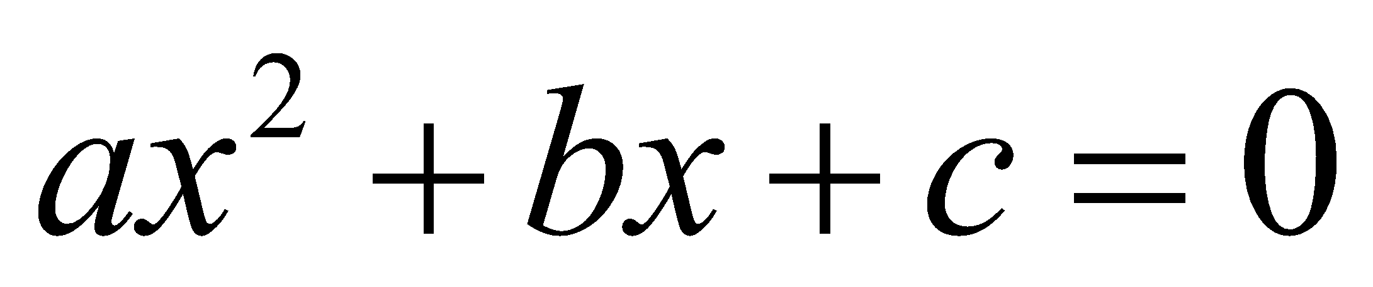
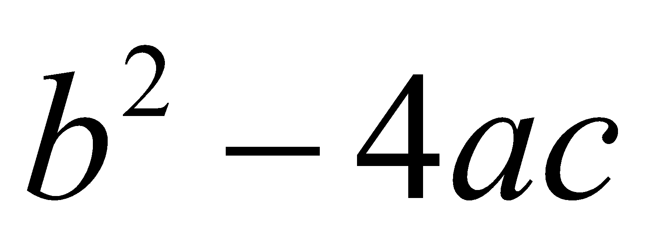
Example 4
Write an algorithm and draw a flowchart that will calculate the roots of a quadratic equation
Hint: d = sqrt ( ), and the roots are: x1 = (–b + d)/2a and x2 = (–b – d)/2a

Slide 98
Flowchart – example 1
Begin
Read birth date
Calculate
Age = current year – birth date
Display
age
End
98

Slide 99
Algorithm for interchanging the numeric values of two variables
Algorithm to check whether a number is odd or even

Slide 100
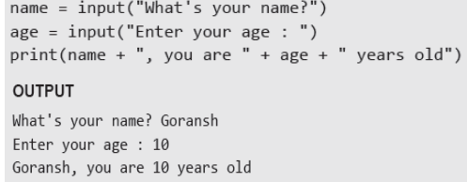
Accepting Input from Console: Input()
User enters the values in the Console and that value is then used in the program as it is required. To take input from the user we make use of a built-in function input().

Slide 101
We can also typecast this input to integer, float, or string by specifying the input() function inside the type.
1. Typecasting the input to Integer: There might be conditions when you might require integer input from the user/Console, the following code takes two input(integer/float) from the console and typecasts them to an integer then prints the sum.
Example:
num1 = int(input())
num2 = int(input())
print(num1 + num2)
Typecasting the input to Float: To convert the input to float the following code will work out.
Example:
num1 = float(input())
num2 = float(input())
print(num1 + num2)

Slide 102
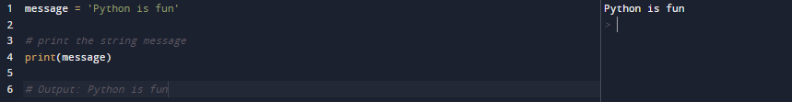
Output using print() function
The print() function prints the given object to the standard output device (screen) or to the text stream file.
Example:
What does print() function do? Takes arguments converts them into human readable form and sends the resulting data to output device.
What arguments does print() expect? Print() is able to operate with all data types.
What value does the print() function return? It does not return any value.

Slide 103
String Literals
String literals in python’s print statement are primarily used to format or design how a specific string appears when printed using the print() function.
\n : This string literal is used to add a new blank line while printing a statement.
“” : An empty quote (“”) is used to print an empty line.
Example:
print("GeeksforGeeks \n is best for DSA Content.")
Output:
GeeksforGeeks
is best for DSA Content.

Slide 104
Print end command
By default, print function in Python ends with a newline. This function comes with a parameter called ‘end.’ The default value of this parameter is ‘\n,’ i.e., the new line character. You can end a print statement with any character or string using this parameter. This is available in only in Python 3+
Example:
print ("Welcome to", end = ' ')
print (“KJSCE", end = '!')
Output:
Welcome to KJSCE!

Slide 105
Print Option : sep=
By default, print() separates the items by spaces.
The optional sep= parameter sets a different separator text.
Example:
a=12
b=12
c=2022
print(a,b,c,sep="-")
Output:
12-12-2022

Slide 106
What is Comment in Python?
The comments are descriptions that help programmers to understand the functionality of the program. Thus, comments are necessary while writing code in Python.
In Python, we use the hash (#) symbol to start writing a comment. The comment begins with a hash sign (#) and whitespace character and continues to the end of the line.
Many programmers commonly use Python for task automation, data analysis, and data visualization. Also, Python has been adopted by many non-programmers such as analysts and scientists.

Slide 107
Python Indentation
Python indentation is a way of telling a Python interpreter that the group of statements belongs to a particular block of code.
A block is a combination of all these statements. Block can be regarded as the grouping of statements for a specific purpose.
Most programming languages like C, C++, and Java use braces { } to define a block of code.
Python uses indentation to highlight the blocks of code. Whitespace is used for indentation in Python.
All statements with the same distance to the right belong to the same block of code.
If a block has to be more deeply nested, it is simply indented further to the right. You can understand it better by looking at the following lines of code.

Slide 108

